Slide 1

Research on the Lithography Hotspot Detection Based on Machine
Chenyu Guo | 12131217
Jia Liu | 12132407
Yunping Song | 12131063
Wenbo Ma | 12132410
Yonghuang Hu | 12131117

Slide 2
CONTENT
Define the Problem
Literature Review
Research Plan
Conclusion

Slide 3
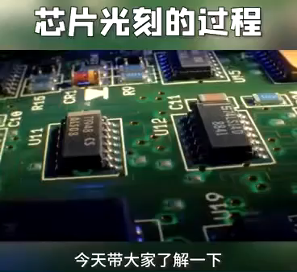
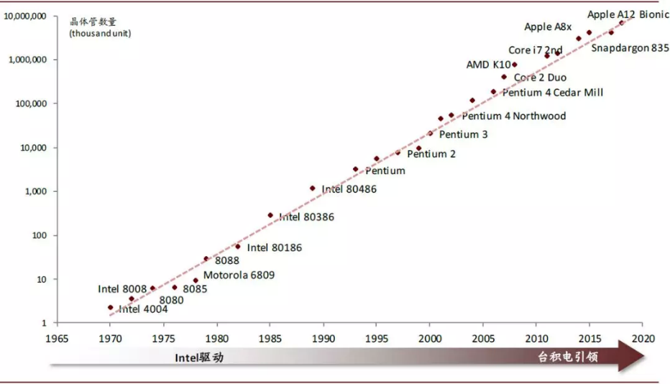
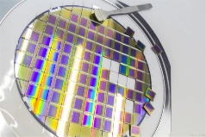
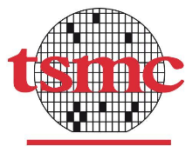
BACKGROUND
Taiwan Semiconductor Manufacturing Company (TSMC)- Global foundry leader!
Silicon Wafer
Fig 1.1：TSMC continues to break through the boundaries of Moore's Law.
Fig 1.2：Chip lithography process.
To improve the imaging resolution, we need a lithography machine with a shorter wavelength.
[1] Gai, T. , et al. (2019).
[2] https://cn.bing.com/images.
[3] https://act.jcpeixun.com/topic/20200512/app.aspx.

Slide 4
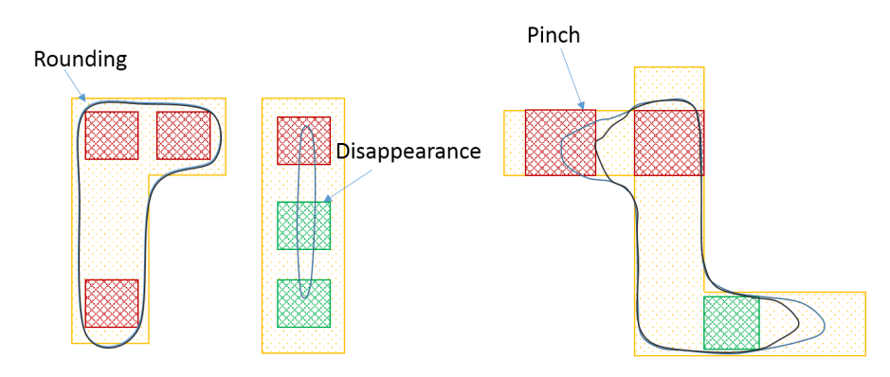
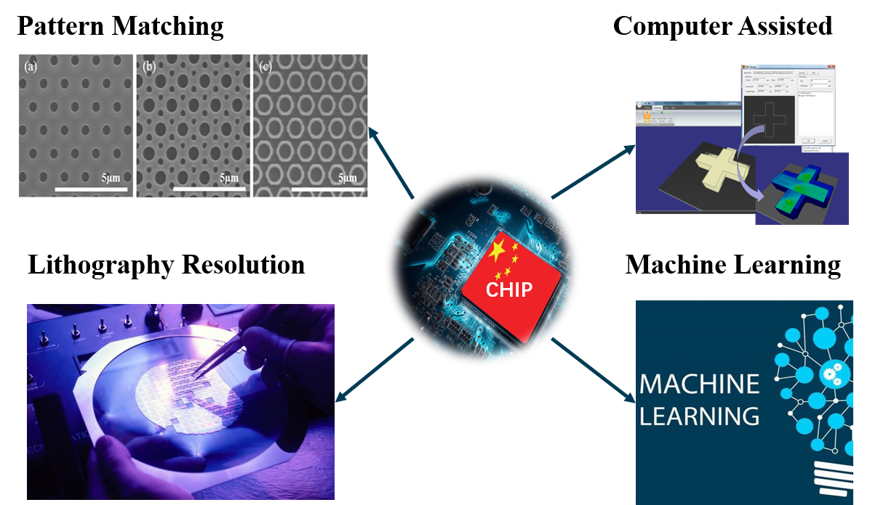
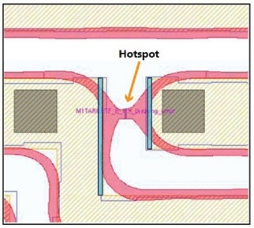
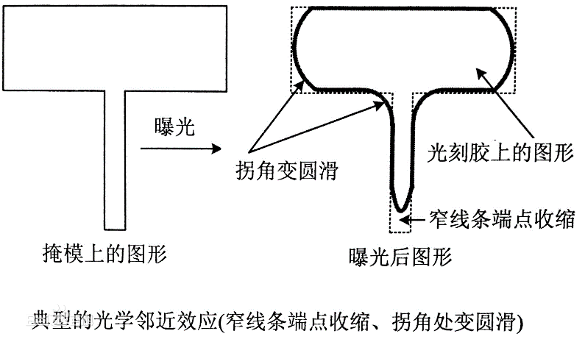
BACKGROUND
（a）
（b）
(c)
Fig 1.3: Schematic diagram of different types of Hotspots.
Fig 1.4: Critical technology.
The combination of traditional methods，such as the lithography simulation model and pattern matching may be the best way to apply the hotspot detection technology based on machine learning to the actual production.
[4] https://baike.baidu.com/item/%E5%9D%8F%E7%82%B9/22331566.

Slide 5
EXISTING METHODS
Based on lithography simulation:
Advantages：
The result of the simulation is very accurate, and it can be served as a standard answer.
Drawbacks:
It can’t handle ultra-scale circuit nowadays because it will cost a lot of time.
Due to business secrets, designers can’t get specific data of lithography models.
Import lithography model
Optical proximity correction
Simulation verify
Hotspot detection
Map modification

Slide 6
EXISTING METHODS
Based on hotspot database and pattern recognition:
Advantages:
Decrease computation consume
Drawbacks:
Hotspot omission for the Incompleteness of database
Hotspot misjudgment for the precision of classification
Extract hotspot map
Classify the hotspot
Select key hotspot
Build hotspot database
How to detect unknown hotspot out of database?
Find matching hotspot

Slide 7
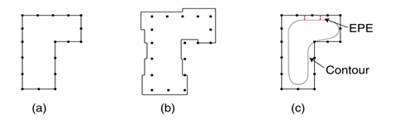
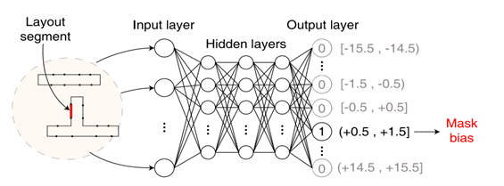
EXISTING METHODS
Based on Machine Learning (ML):
The goal of optical proximity correction (OPC) then is to synthesize a mask pattern, which produces the target aerial image (set by EPC) under light interference.
Fig 1.5: OPC steps: (a) after fragmentation, (b) correction of mask pattern,and (c) lithography simulation result (Contour) compared to targetpattern to calculate EPE.
Fig 1.6: ML-OPC using MLP (multilayer perceptron) model.
A number of OPC methods using machine learning models (ML-OPC) have been proposed to provide a quick OPC solution. The idea is illustrated in Fig. 3.
[5] Viswanathan R, et al. 2012: 83261A.

Slide 8
COMPARISON OF EXISTING METHODS
√ High accuracy
√ Higher detection efficiency
× Cannot handle unseen hotspots
Recognize even unseen hotspots with high accuracy.
Lithography Simulation
Database and Pattern Recognition
Machine Learning
√ High detection accuracy
× Computationally expensive
Hybrid Methods
[6] Chen, Y, et al. 2020.

Slide 9
OUTLINE
Define the Problem
Literature Review
Research Plan
Conclusion

Slide 10
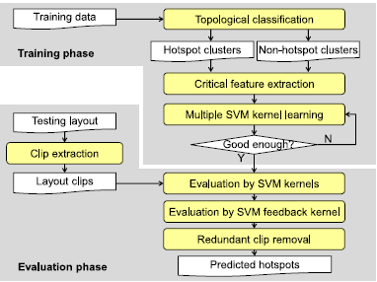
LITERATURE REVIEW 1
Machine-learning-based hotspot detection using topological classification and critical feature extraction
Yu et al. (2015) devise iterative multiple SVM kernel and feedback kernel learning to fully exploit the strengths of machine learning:
combing topological classification and critical feature extraction
With high accuracy and rapid training convergence
Fig 2.2：Machine-learning based hotspot detection framework.
[1] Yu Y T, et al, 2015, 34(3): 460-470.

Slide 11
LITERATURE REVIEW 2
Hotspot detection using CNN has been proposed. Since hotspots are sparse, it is important to augment sample hotspot patterns so that CNN is well trained.
Park et al. (2018) propose a novel methodology for machine learning-based hotspot detection that uses lithography information to build SVM during its learning process.
This proposed method utilizes detailed optical information but bypasses post-optical proximity correction mask by sampling latent image intensity and uses those points to train an SVM model. The results suggest high accuracy and low false alarm, and faster runtime.
[2] Yang H, et al. 2017: 1014807.
[3] Zhu, J, A, et al. 2017.
[4] Park J W, et al. 2018, 37(7): 1510-1514.

Slide 12
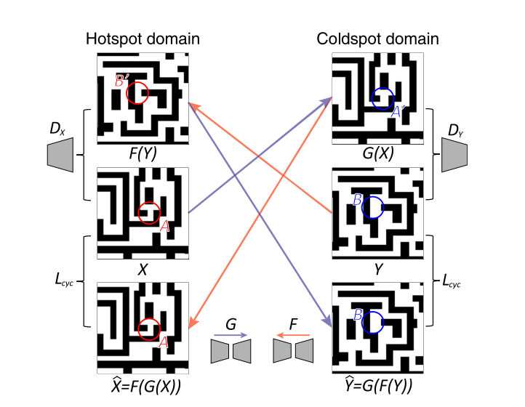
LITERATURE REVIEW 3
SRAFs (insertion and printability check) and hotspot patterns (detection and correction) are also popular applications of machine learning；
Training data is a challenge；
Hotspot patterns as well as printed SRAF samples are often scarce.
Fig 2.3：Hotspot correction using cycleGAN.
Test patterns (extraction, classification, and synthesis) are thus important topic and need more study and development
[5] Sim, W. et al. 2019:1096105.

Slide 13
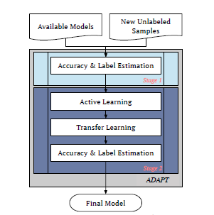
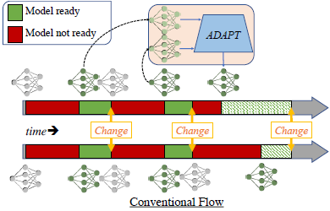
LITERATURE REVIEW 4
ADAPT: An Adaptive Machine Learning Framework with Application to Lithography Hotspot Detection
shorten the maturity cycle of new model in changing environment, to fast migration of machine learning models
features:
adapted to changing environment
unsupervised Bayesian approach
use less data for learning
multiple options for all labeling strategy
[6] M. B. Alawieh, D. Z. Pan. 2021:1-6.

Slide 14
REFERENCES
[1] Yu Y T, Lin G H, Jiang I H R, et al. Machine-learning-based hotspot detection using topological classification and critical feature extraction[J]. IEEE Transactions on Computer-Aided Design of Integrated Circuits and Systems, 2015, 34(3): 460-470.
[2] Yang, H. et al.: Imbalance aware lithography hotspot detection: A deep learning approach, Proc. SPIE 10148, Design-Process-Technology Co-optimization for Manufacturability XI, 1014807 (2017).
[3] Zhu, J., Park, T., Isola, P. and Efros, A.: Unpaired image-to-image translation using cycle-consistent adversarial networks, Proc. Int. Conf. Computer Vision (2017).
[4] Park J W, Torres A, Song X. Litho-aware machine learning for hotspot detection[J]. IEEE Transactions on Computer-Aided Design of Integrated Circuits and Systems, 2018, 37(7): 1510-1514.
[5] Sim, W. et al.: Automatic correction of lithography hotspots with a deep generative model, Proc. SPIE 10961, Optical Microlithography XXXII, 1096105 (2019).
[6] M. B. Alawieh and D. Z. Pan, “ADAPT: An Adaptive Machine Learning Framework with Application to Lithography Hotspot Detection," 2021 ACM/IEEE 3rd Workshop on Machine Learning for CAD (MLCAD), 2021, pp. 1-6.

Slide 15
OUTLINE
Define the Problem
Literature Review
Research Plan
Conclusion

Slide 16
CHALLENGES IN MACHINE LEARNING
Challenges of Machine Learning (ML) application in hotspot detection:
Learning phase
Testing phase
Acquisition of training data
Pre-process: feature extraction of hotspot map
Training process: selection of classification model
Improve model portability
Interpretation of the results
Input training data set
Input testing data set
Optimize & Extract layout features
Extract layout features
Classification model
Machine learning
Prediction

Slide 17
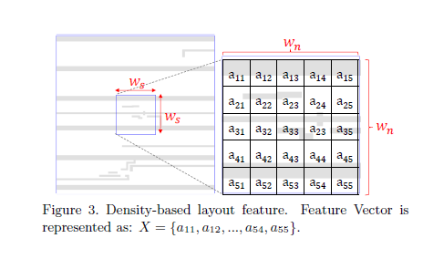
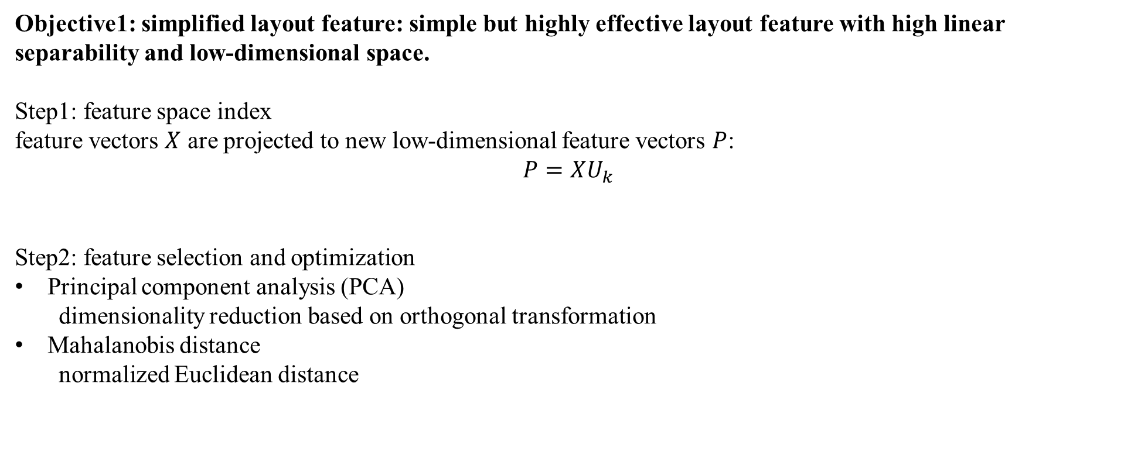
SIMPLIFIED LAYOUT FEATURE
Objective1: simplified layout feature: simple but highly effective layout feature with high linear separability and low-dimensional space.
Step1: feature space index
feature vectors $X$ are projected to new low-dimensional feature vectors $P$:
$$P=XU_{k}$$
Step2: feature selection and optimization
Principal component analysis (PCA)
dimensionality reduction based on orthogonal transformation
Mahalanobis distance
normalized Euclidean distance

Slide 18
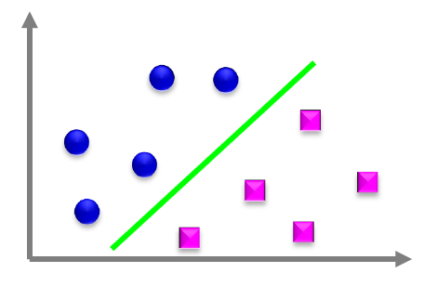
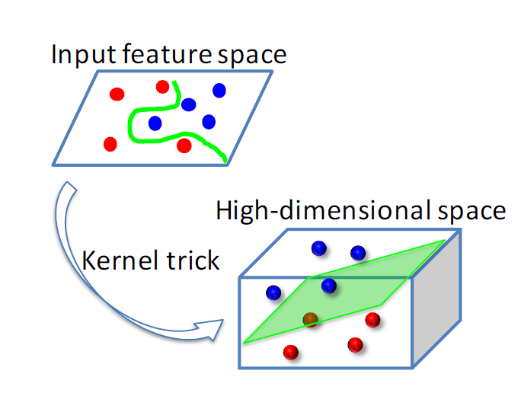
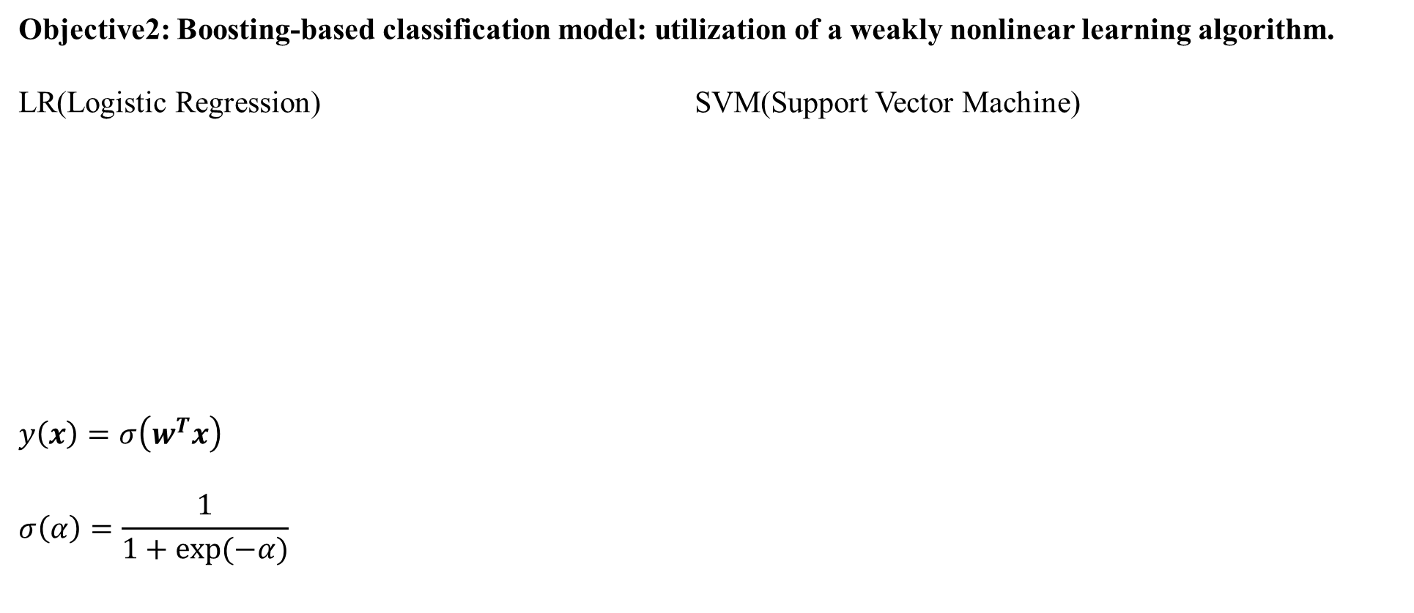
CLASSIFICATION MODEL
Objective2: Boosting-based classification model: utilization of a weakly nonlinear learning algorithm.
LR(Logistic Regression) SVM(Support Vector Machine)
$$y\left(x\right)=σ\left(w^{T}x\right)$$
$$σ\left(α\right)=\frac{1}{1+exp(−α)}$$

Slide 19
ADABOOST ALGORITHM
Objective2: Boosting-based classification model: utilization of a weakly nonlinear learning algorithm.
Hotspot detection is extremely complicated multiclass-classification problem
Hotspot has many defect mode
Conventional method is hard to generalize all variations of hotspot features
Accuracy limitation because of too many factors of hotspot
Adaboost can simultaneously learn many factors of hotspot
Utilize boosting algorithm in conjunction with several classifiers

Slide 20


THANK YOU！
Chenyu Guo（郭晨瑜）
Jia Liu（刘佳）
Yunping Song（宋云平）
Wenbo Ma（马文博）
Yonghuang Hu（胡永煌）
1
Date: Sunday, November 14, 2021

Slide 21

DISCUSSION！

